Slide 1
COMP 1842
Week 4 part 2 – CSS Selectors
Matt Prichard

Slide 2
Introduction
The two hardest parts of beginning CSS are manipulating the box model without going mad and understanding CSS selectors.
The actual styling part is quite simple, picking fonts and colours etc.
https://www.freecodecamp.org/news/css-selectors-cheat-sheet/

Slide 3
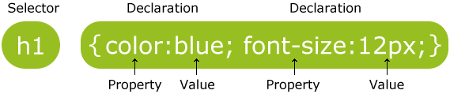
Recap
http://www.w3schools.com/css/css_syntax.asp
The selector is how we target the element/s we wish to style
They start off simple but can become quite involved.

Slide 4
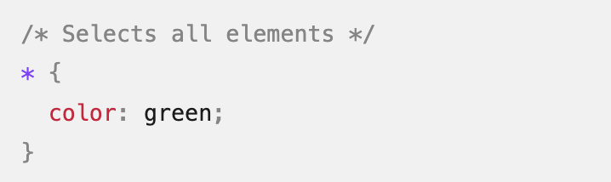
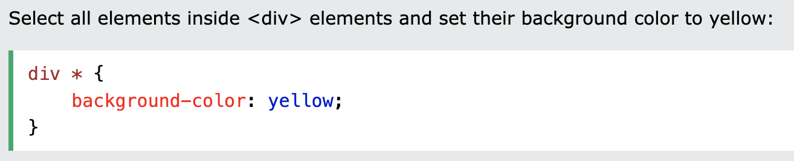
Universal selectors
http://www.w3schools.com/css/css_syntax.asp

Slide 5
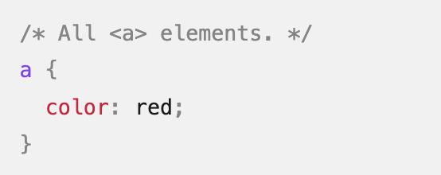
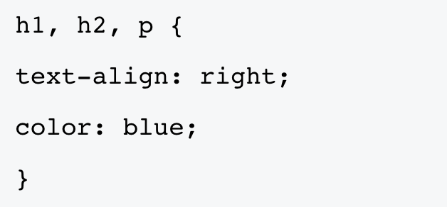
Element or tag selectors
CSS Element Selector, also called a Tag selector is a selector that selects all the HTML elements by a specified names on a web page. It is the most basic selector of all. Elements can be grouped.

Slide 6
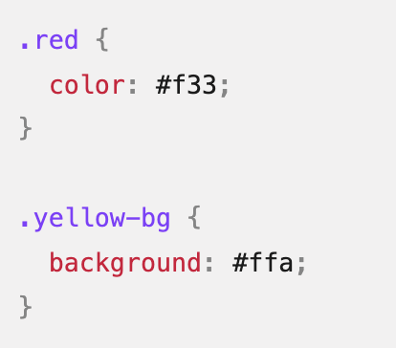
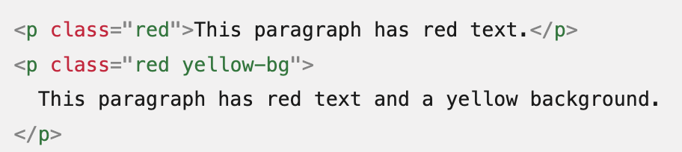
Class selectors
Selects all elements with the ‘red’ class. The syntax is a dot in CSS and the word class in the html, again these can be combined.

Slide 7
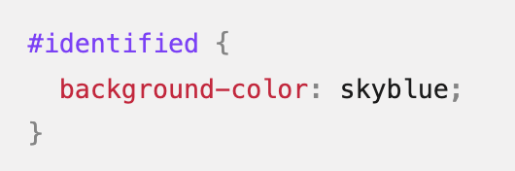
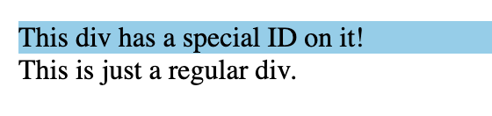
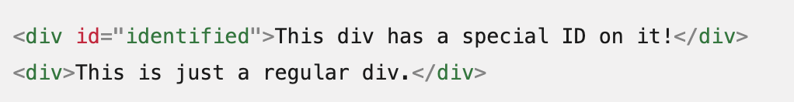
Id selectors
The id selector uses the id attribute of an HTML element to select a specific element. The id of an element is unique within a page, so the id selector is used to select one unique element!

Slide 8
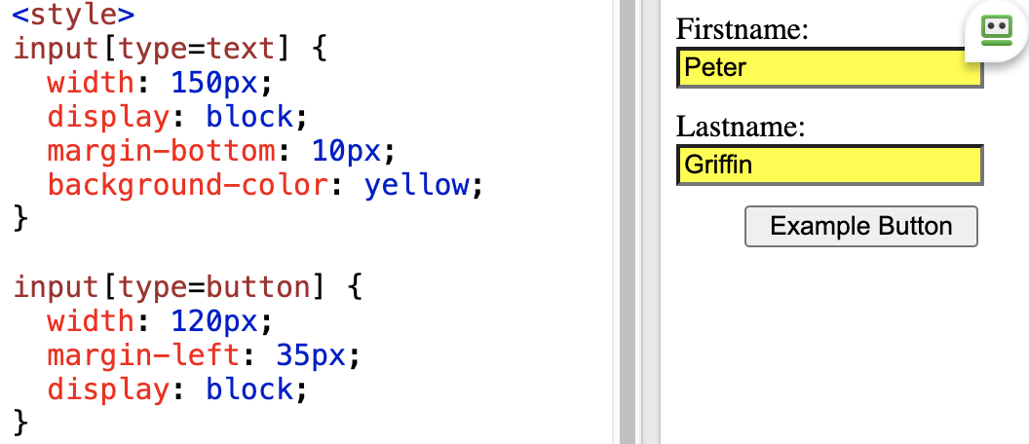
Attribute selectors
The [attribute] selector is used to select elements with a specified attribute. Very useful for styling forms.

Slide 9
Combinators

Slide 10
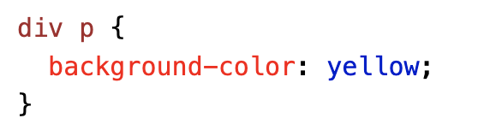
Descendent combinator
The descendant selector matches all elements that are descendants of a specified element.
The following example selects all <p> elements inside <div> elements:
slide10.html

Slide 11
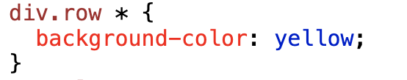
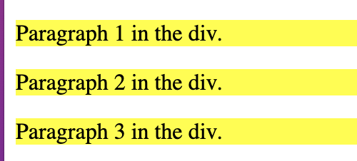
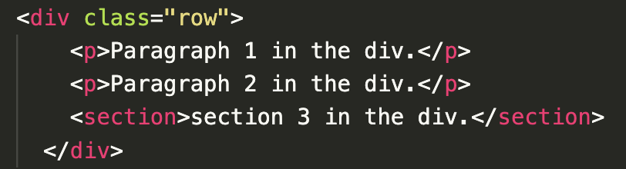
Descendent combinator
selects all elements that are descendant (or child) of the elements with div tag and ‘row’ class
slide11.html

Slide 12
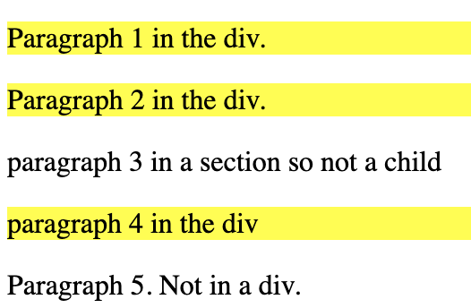
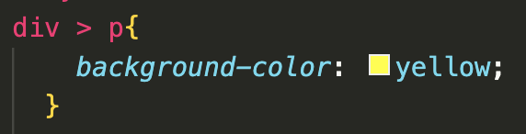
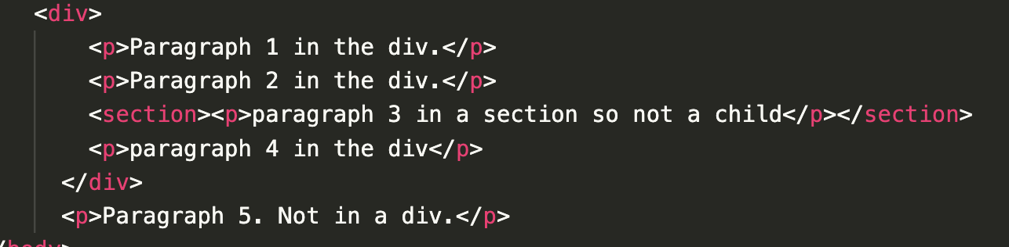
Child combinator
The child combinator (>) is placed between two CSS selectors. It matches only those elements that are the direct children of the first.
slide12.html

Slide 13
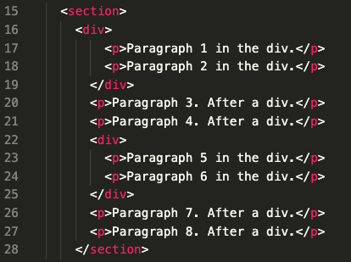
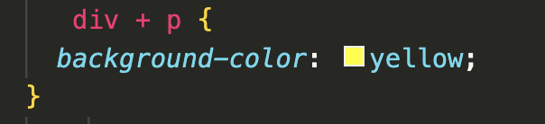
Adjacent Sibling Selector(+)
It selects the element that is immediately preceded by the former element. Sibling elements must have the same parent element, and "adjacent" means "immediately following".
slide13.html

Slide 14
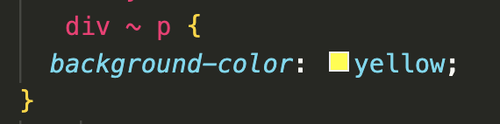
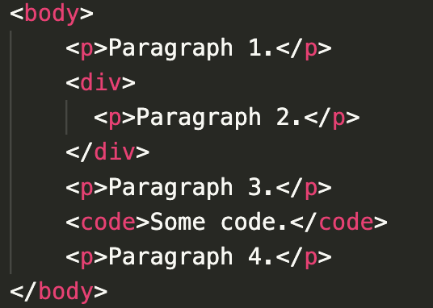
General Sibling Selector (~)
The general sibling selector (~) selects all elements that are next siblings of a specified element. The following example selects all <p> elements that are next siblings of <div> elements:
slide14.html

Slide 15
Pseudo selectors & Pseudo classes

Slide 16
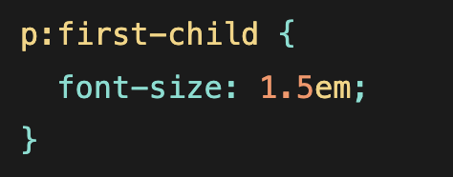
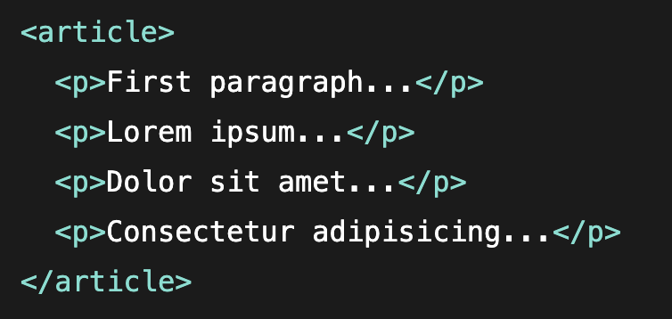
:first-child
The :first-child selector allows you to target the first element immediately inside another element.
slide16.html

Slide 17
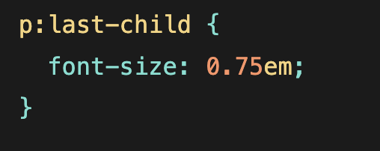
:last-child
The :last-child selector allows you to target the last element immediately inside another element.
slide16.html

Slide 18
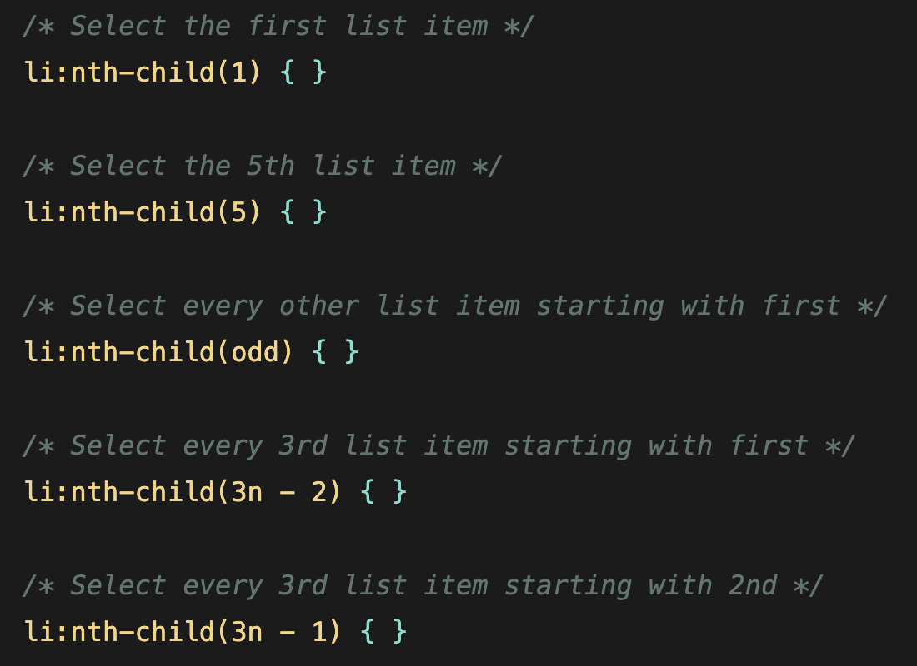
:nth-child()
Target the nth element immediately inside (or child of) another element. Admits integers, even, odd, or formulas
https://css-tricks.com/almanac/selectors/n/nth-child/

Slide 19
a:not(.name)
Selects all a elements that are not of the .name class
This can go on and on

Slide 20
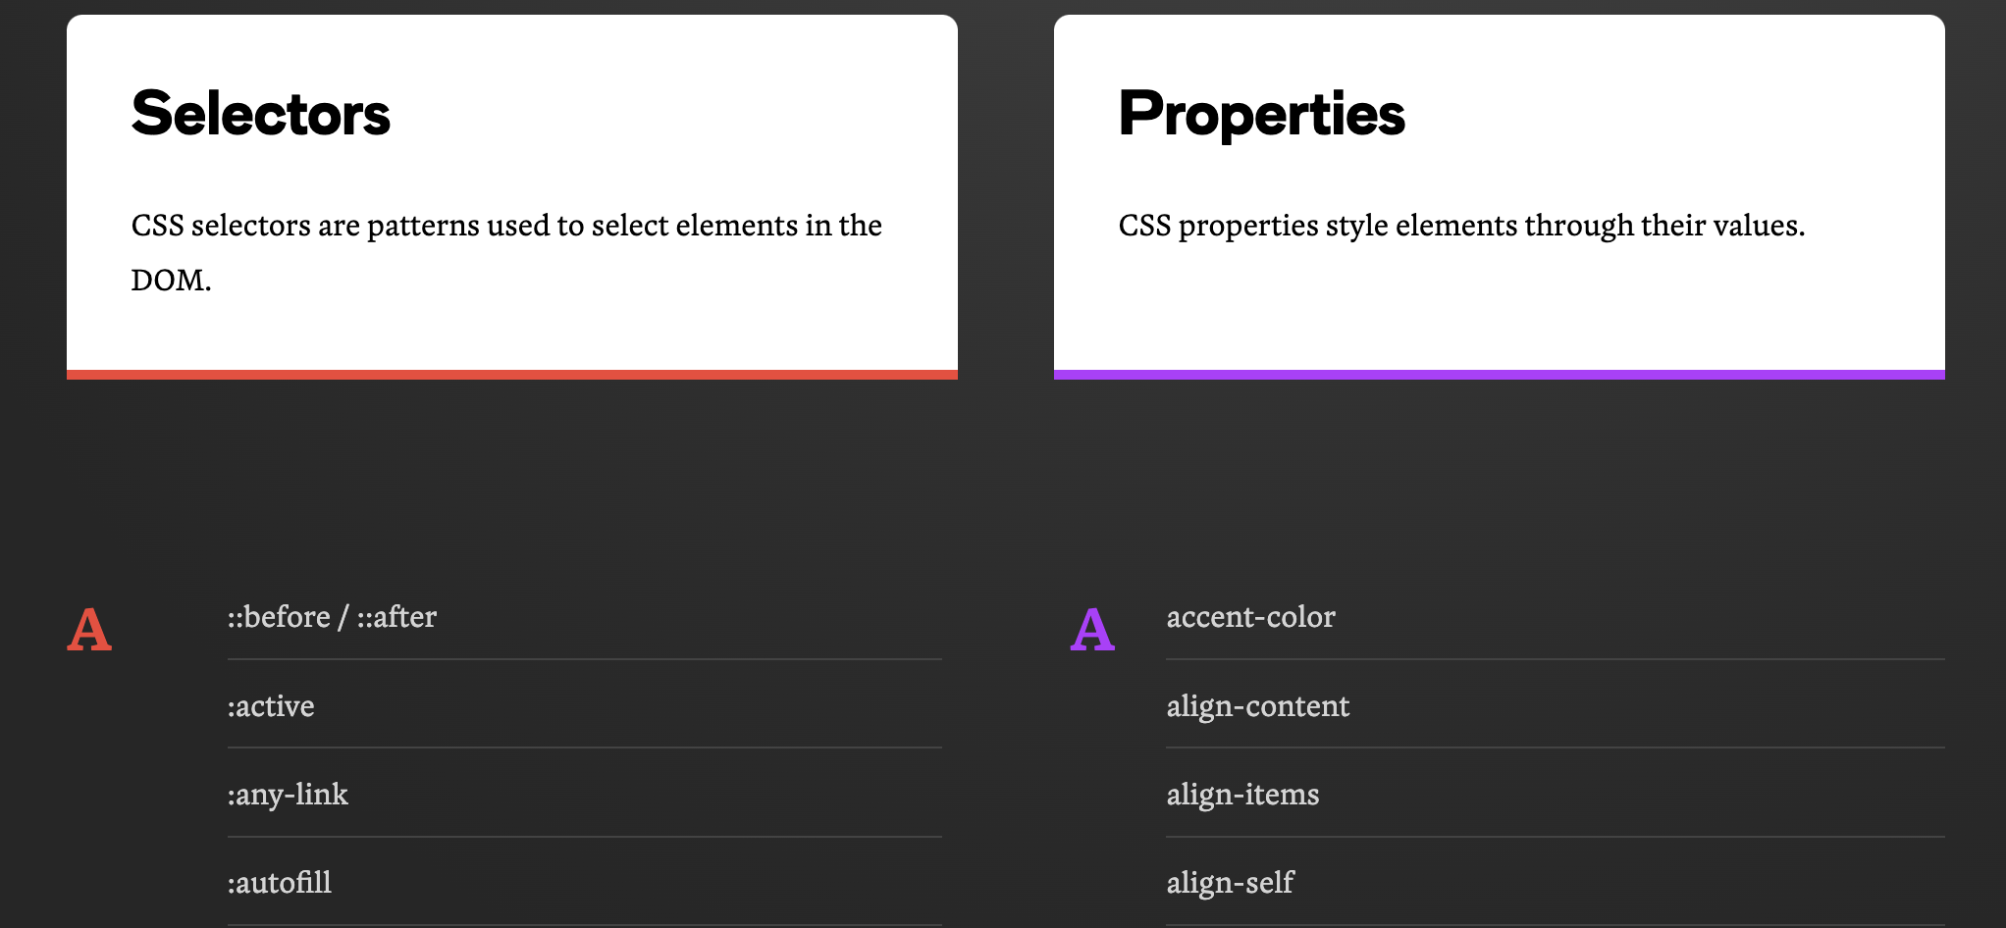
Scary full list
https://css-tricks.com/almanac/
https://developer.mozilla.org/en-US/docs/Web/CSS/Reference

Slide 21
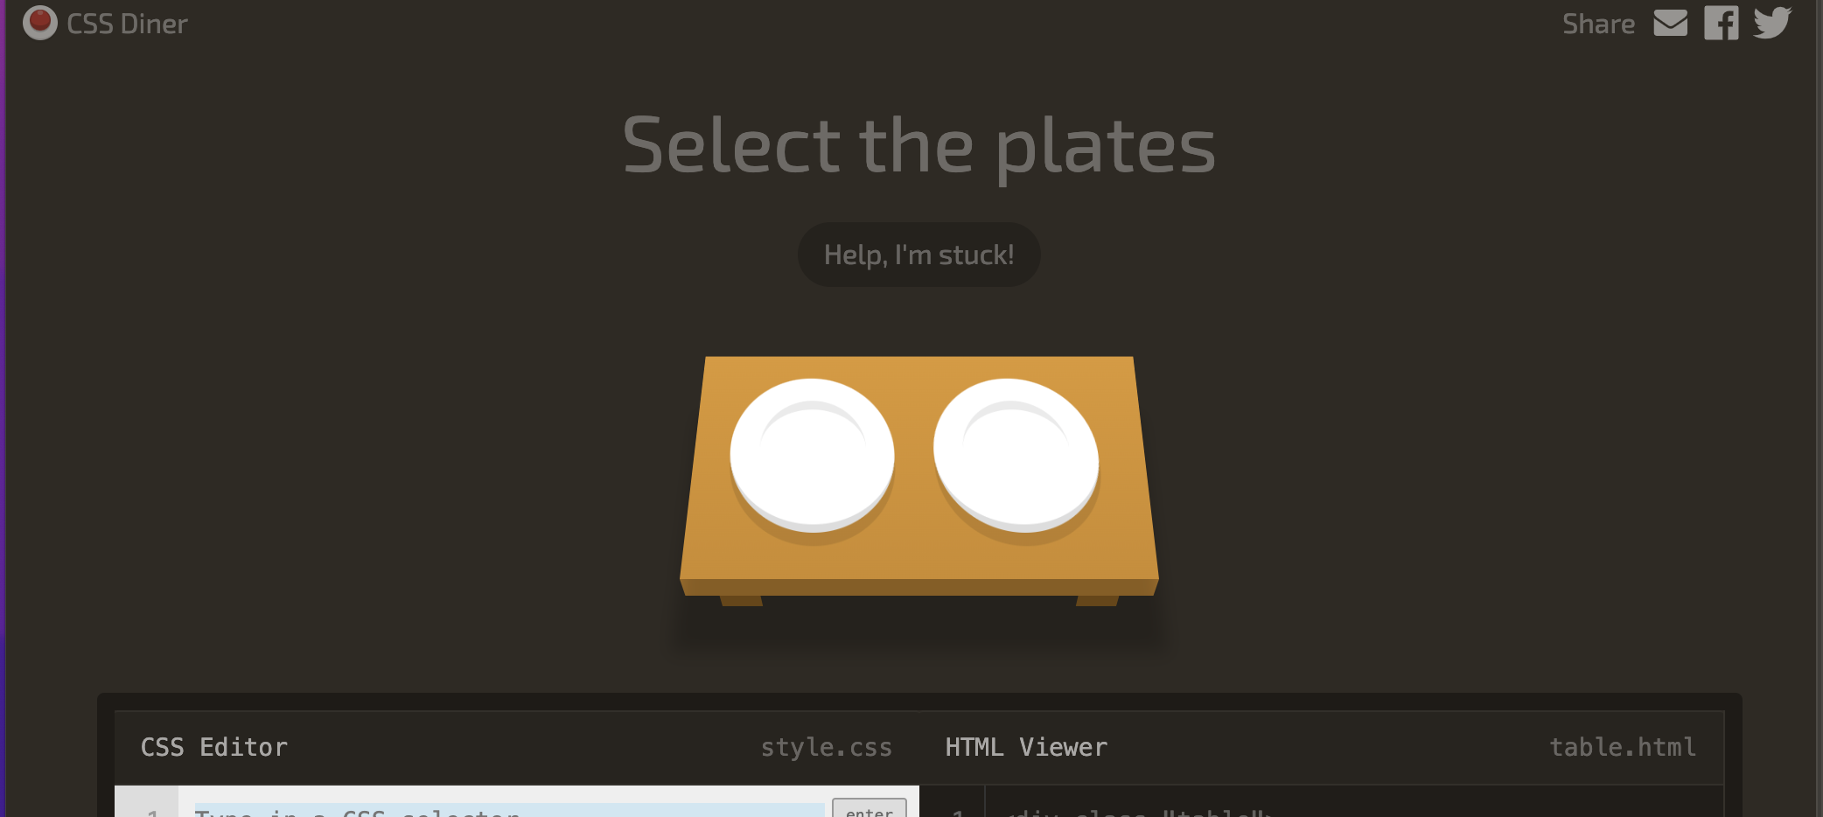
CSS Diner game
https://flukeout.github.io/

Slide 22
?

